Slide 1
CIND 820 Final Project Ryan Boyd 501072988
LiDAR Point Cloud Object Extraction

Slide 2
Introduction: Project Goal and Research Question
Distinguish individual features from lidar point cloud
Use clustering algorithms to group by proximity, height, surface reflectance.
Improve classification

Slide 3
Tools
Python
Jupyter notebooks
Pandas
Sci-kit learn
Laspy
Matplotlib
Python Image Library (PIL/pillow)
QGIS
Clipping DEM, Imagery
3D Visualization

Slide 4
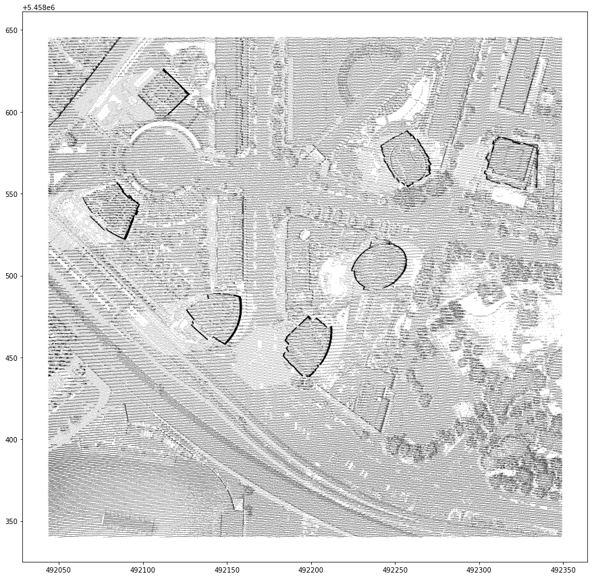
LiDAR LAS Data Point Cloud
798,900 total points
70,247 classified ground
728,653 unclassified
Attributes:
X
Y
Z
Intensity
Classification
Return Number
Return Count

Slide 5
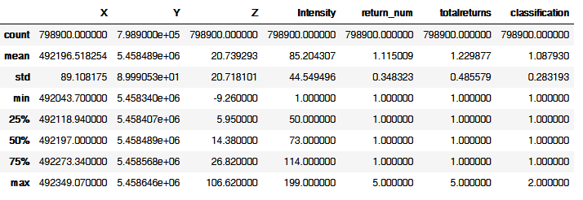
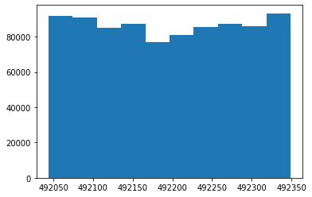
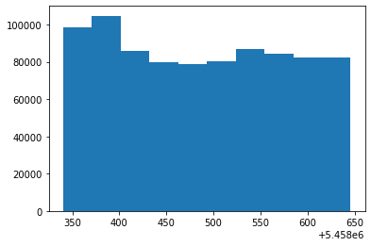
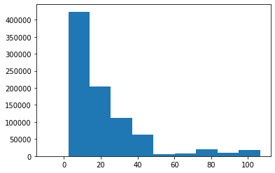
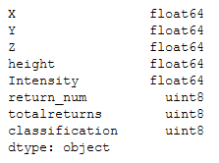
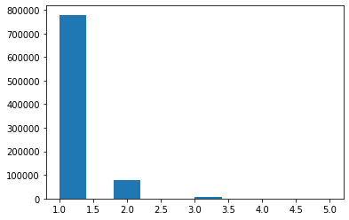
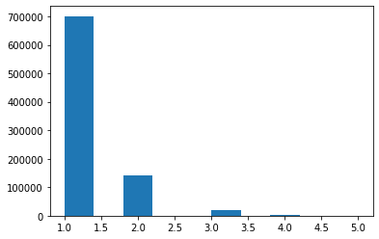
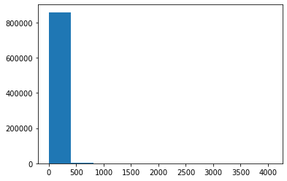
Descriptive Statistics

Slide 6
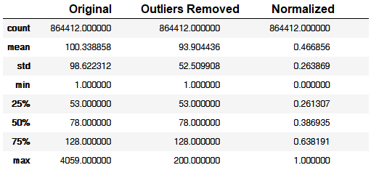
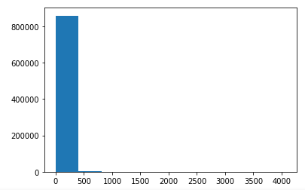
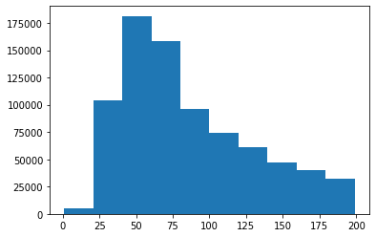
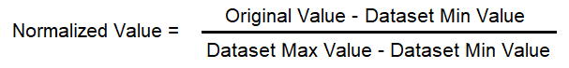

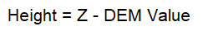
Preprocessing
Outliers removed – Intensity:
Data normalized
Height relative to ground extracted
R,G,B values from imagery extracted

Slide 7
Models/Algorithms
Random Forest Decision Tree
Used to classify ground
K-means clustering
Used to classify by height(Z) and intensity
DBSCAN spatial clustering
Classifies by spatial(X,Y) proximity

Slide 8
Performance Measures
Confusion Matrix and accuracy for supervised
Silhouette Score
Measure of cluster overlap
Between -1 and 1
Calinski-Harabsz Score
aka Variance Ratio Criterion
Ratio of distance of points within clusters to distance of cluster centres
Model Fit/Training Time
Cluster count and total points clustered

Slide 9
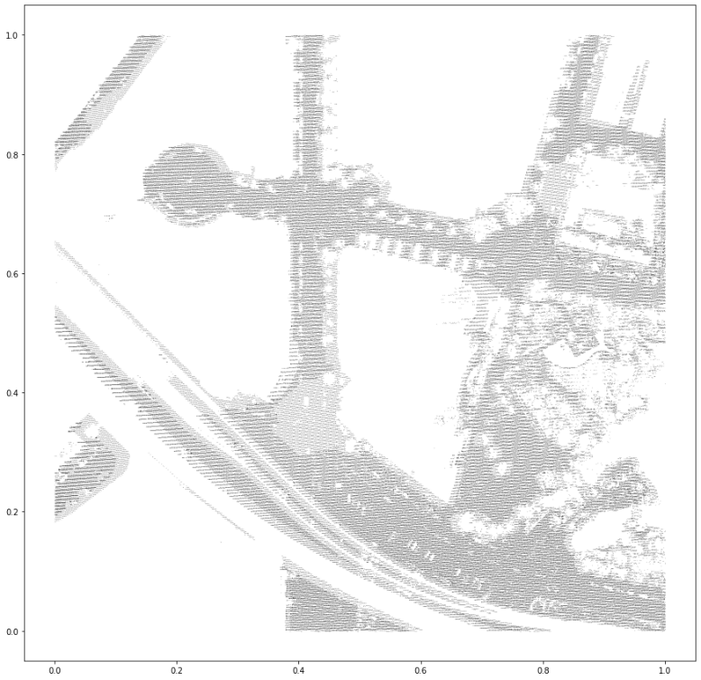
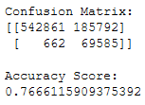
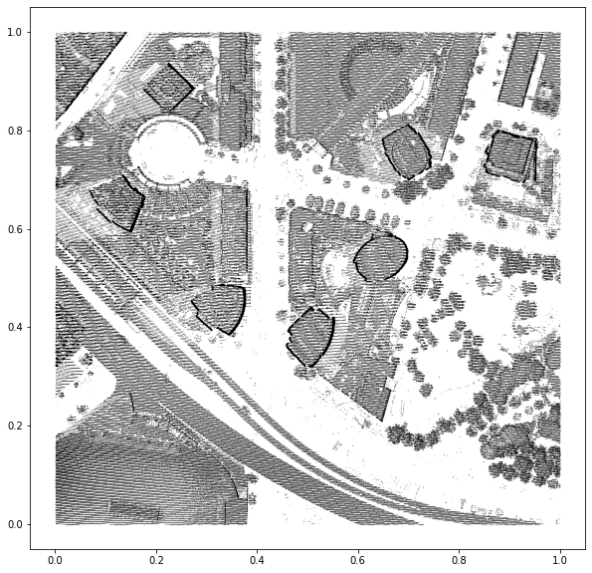
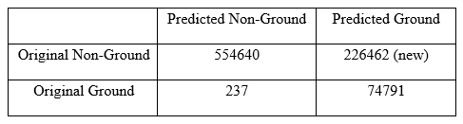
Random Forest: Ground (re)classification
Inputs:
Height
Intensity
Return Number Ratio
Labels:
Provided class 1 ground points
30s runtime
76% Accuracy

Slide 10
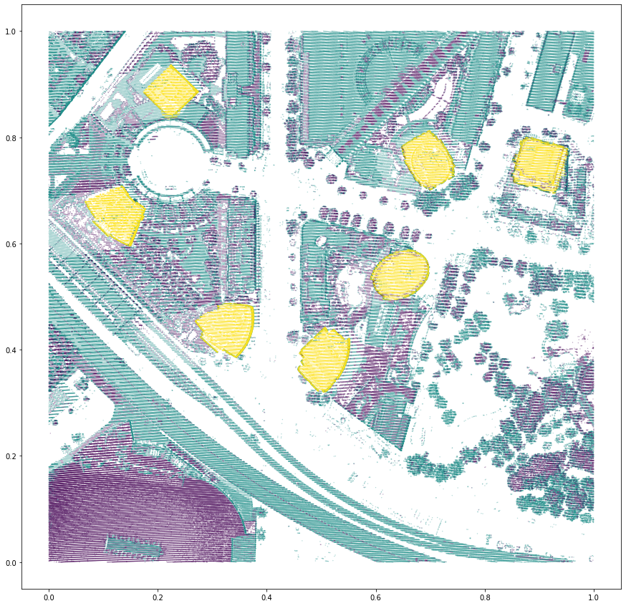
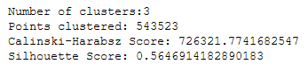
K-Means Clustering
Inputs:
Height
Intensity
Return Number Ratio
Parameters:
K=3
Determined by testing and maximizing performance scores
3s runtime
0.56 Silhouette Score

Slide 11
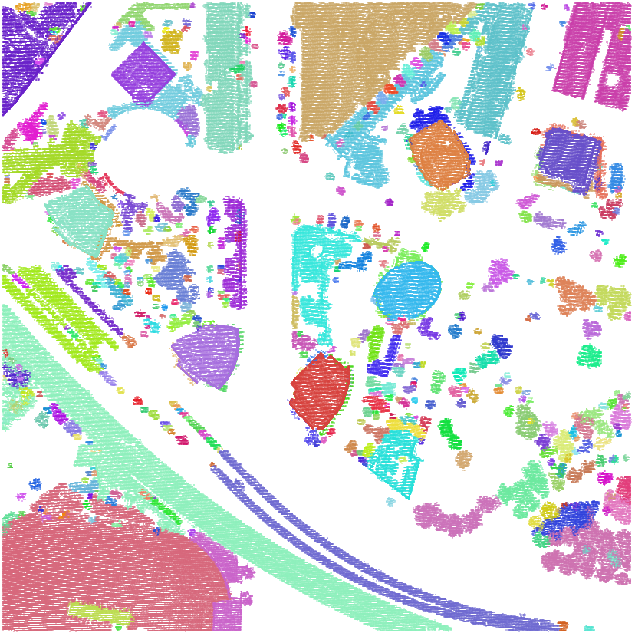
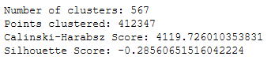
DBSCAN: Spatial Clustering
Inputs:
X
Y
K-means cluster id
Parameters:
‘eps’ = 0.005
Minimum distance between points
min_points = 50
Points required to make a cluster
5min runtime
-0.27 Silhouette Score

Slide 12
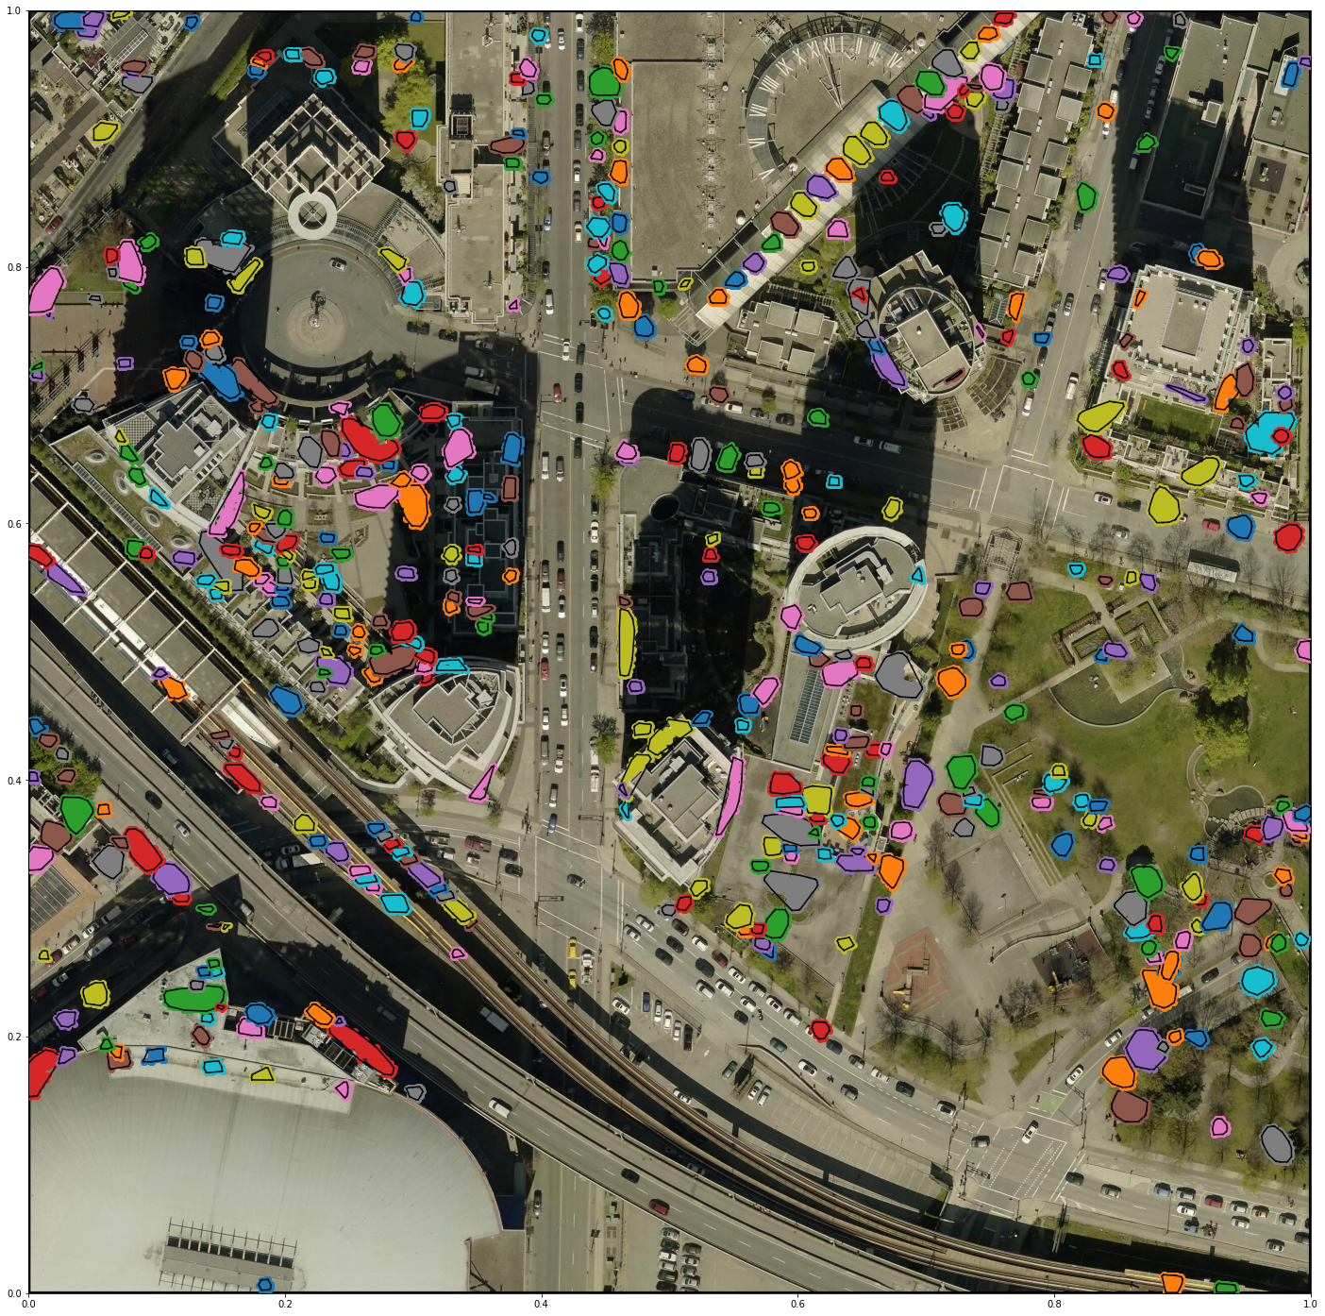
Small Clusters
Less than 500 points
489 features
Trees
Balconies
Window panes
Rooftop features

Slide 13
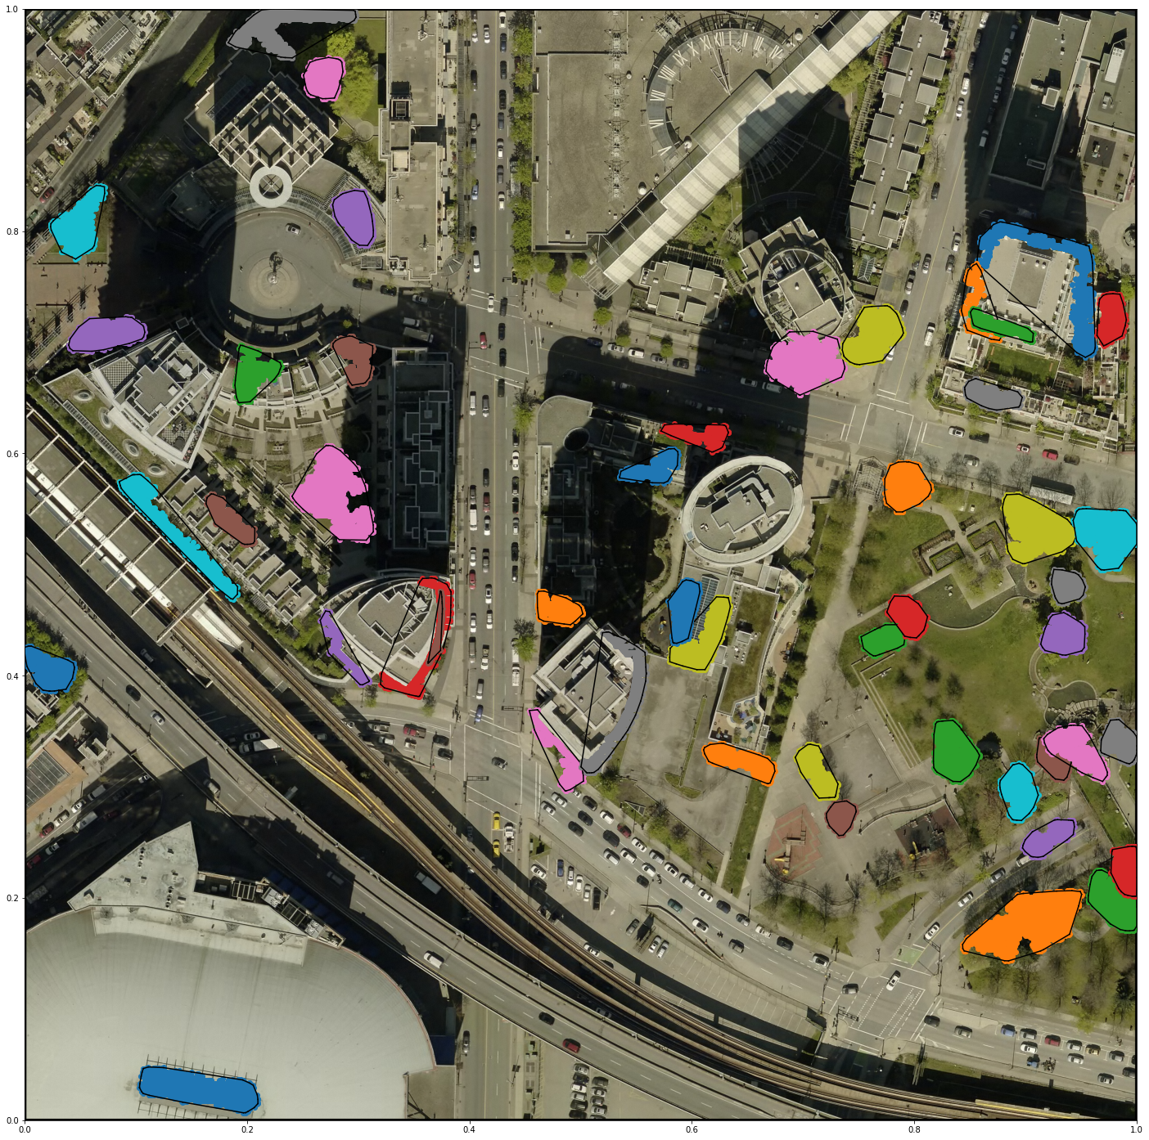
Medium Clusters
Between 500 and 2500 points
48 features
Large tree canopies (likely lower height)
Balconies

Slide 14
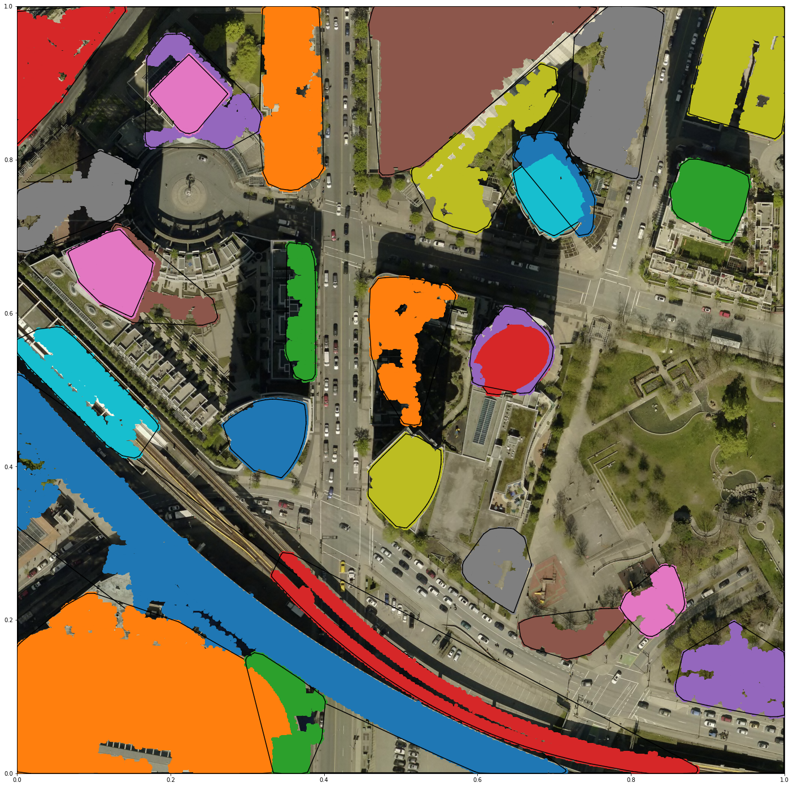
Large Clusters
Over 2500 points
29 features
Building footprints
Large canopies
Large Buildings
Raised roadway
Raised Railway

Slide 16


Slide 17
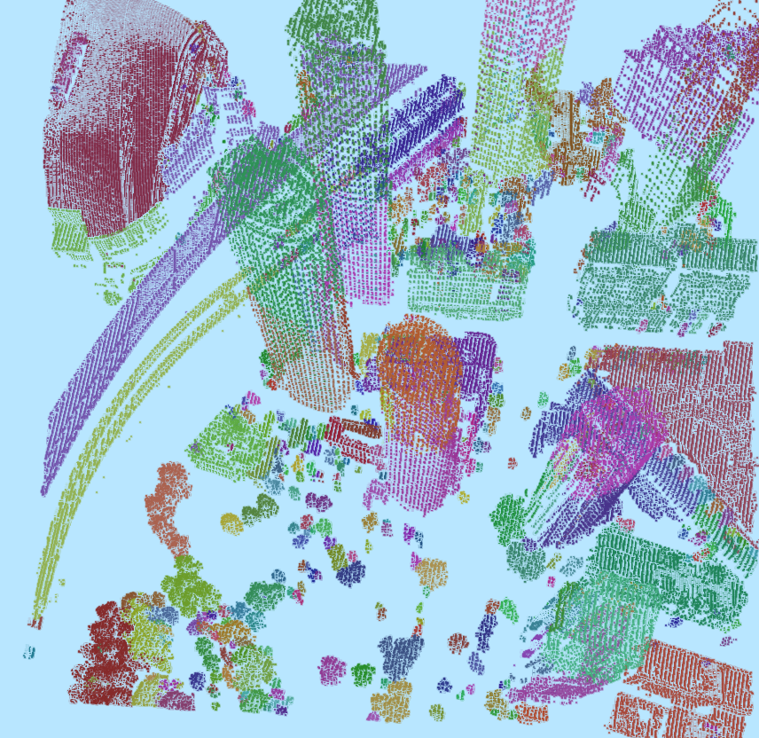

Slide 18
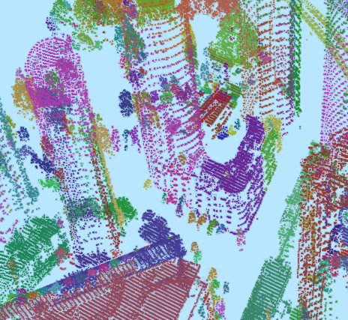

Slide 19
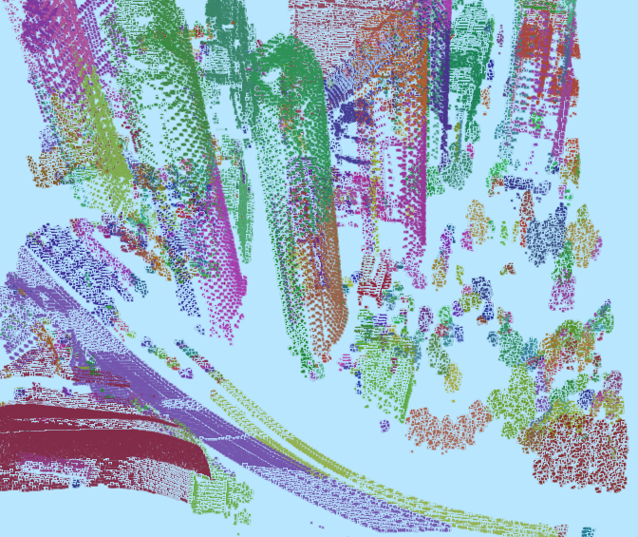

Slide 21
Thank you. Questions

